Slide 1
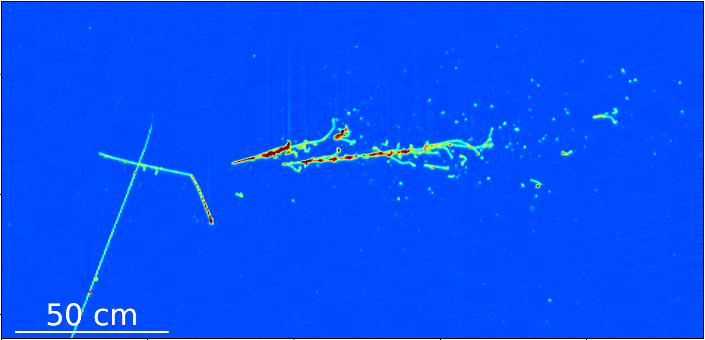
First results on ProtoDUNE single-phase LArTPC performance
Pion-Ar: Charge Exchange Process
Wenqiang Gu
Brookhaven National Laboratory
arXiv:2007.06722 [physics.ins-det]
Notes:
Cite performance paper here

Slide 2
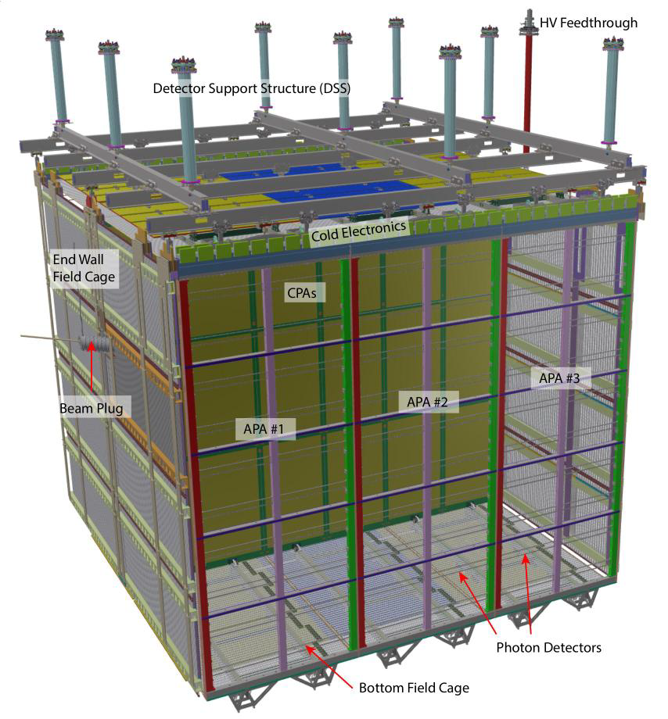
Outline
Deep Underground Neutrino Experiment (DUNE)
Liquid Argon Time Projection Chamber (LArTPC)
History for LArTPC
Why Liquid Argon for DUNE?
Challenges for building multiple 10-kton detectors
ProtoDUNE-SP: single-phase prototype for DUNE
Construction and operation
First results on the performance
Other ongoing analyses
6m
7.2m
7m
Notes:
Be consistent in target mass
These questions bring me to today’s tpic: the DUNE experiment
I will introduce the lArTPC tennology, the major detector technology used in DUNE. Finally, the performance of the first prototype of out SP LArTPC detector will be presented

Slide 3
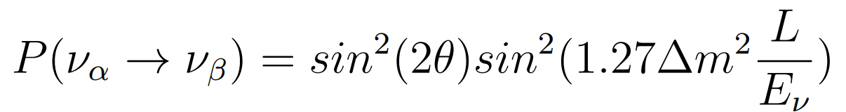
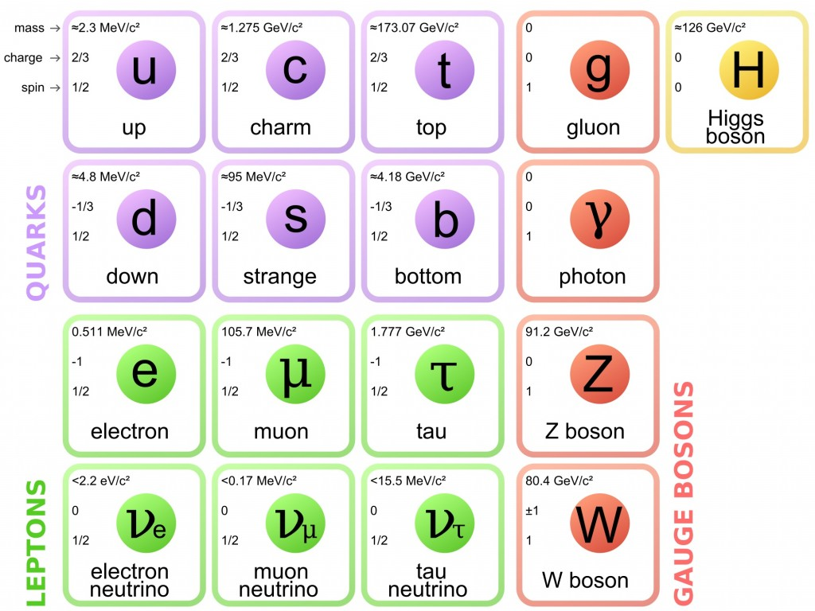
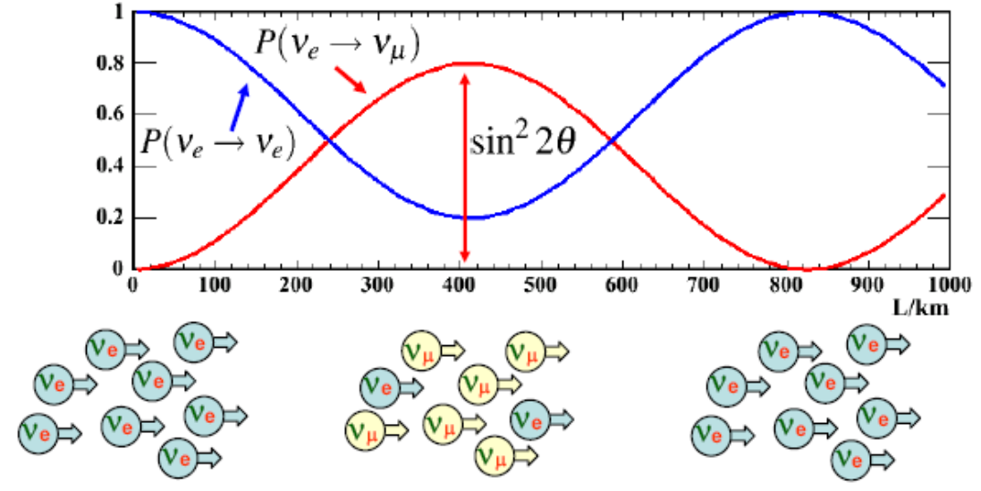
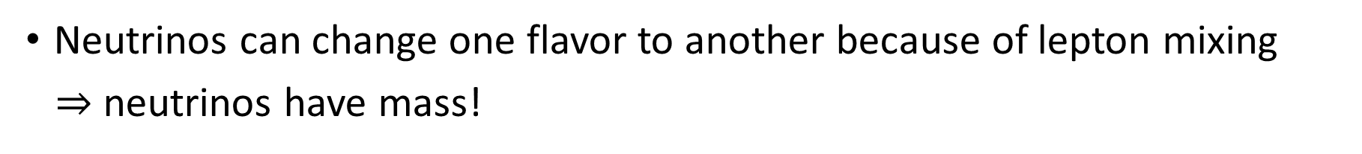
Neutrino Oscillation
Neutrinos can change one flavor to another because of lepton mixing
$⇒$ neutrinos have mass!
Mass splitting
Standard Model of Elementary Particles
Notes:
Before I move on to introduce our experiment, I want to start with the particle are going to study, the neutrinos.
Besides of photon, Neutrino is the most abundant and lightest elementary particles in the universe

Slide 4
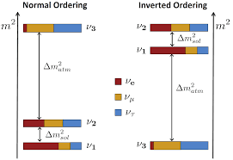
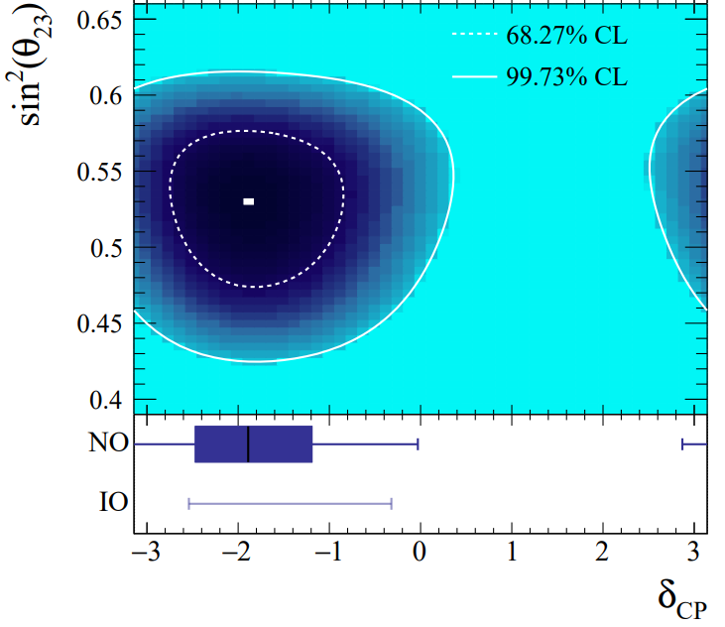
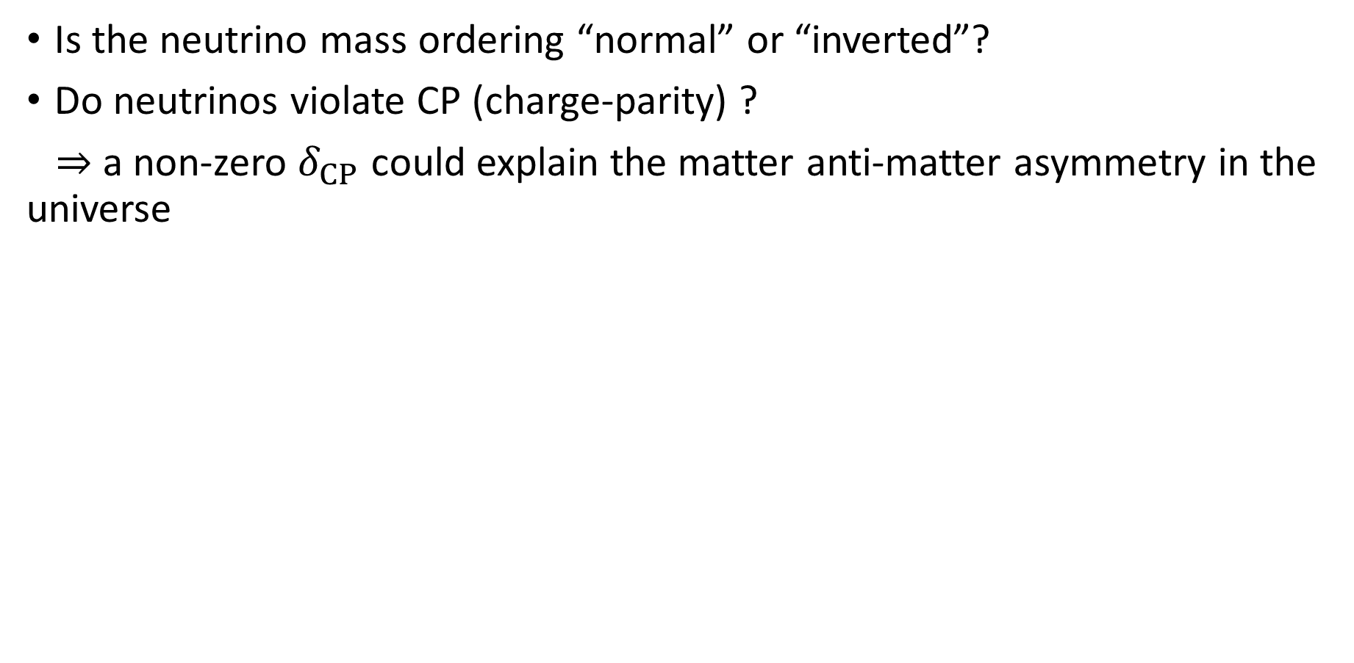
Open Questions
Is the neutrino mass ordering “normal” or “inverted”?
Do neutrinos violate CP (charge-parity) ?
$⇒$ a non-zero $δ_{CP}$ could explain the matter anti-matter asymmetry in the universe
T2K
Nature 580, 339–344 (2020)

Slide 5
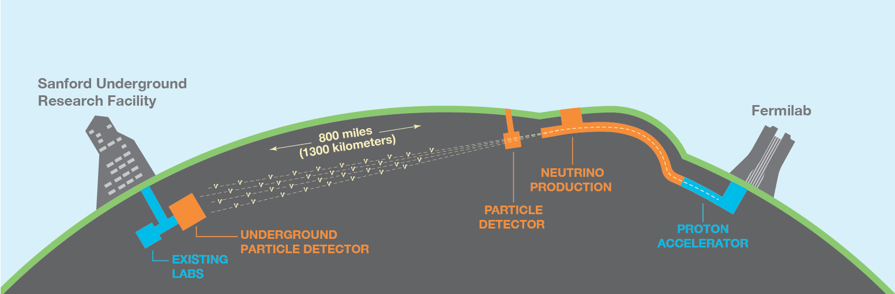
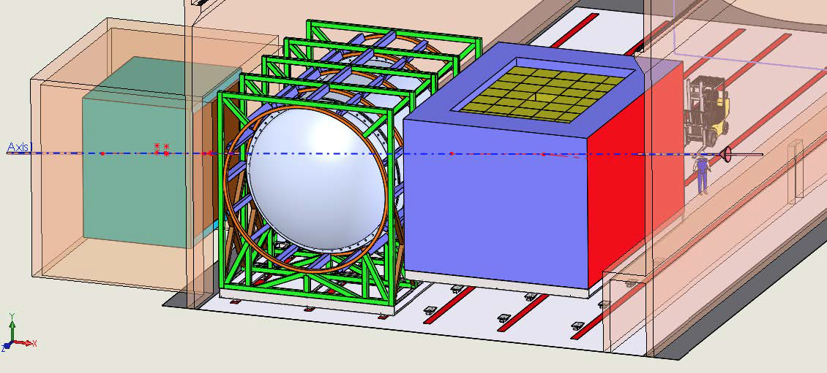
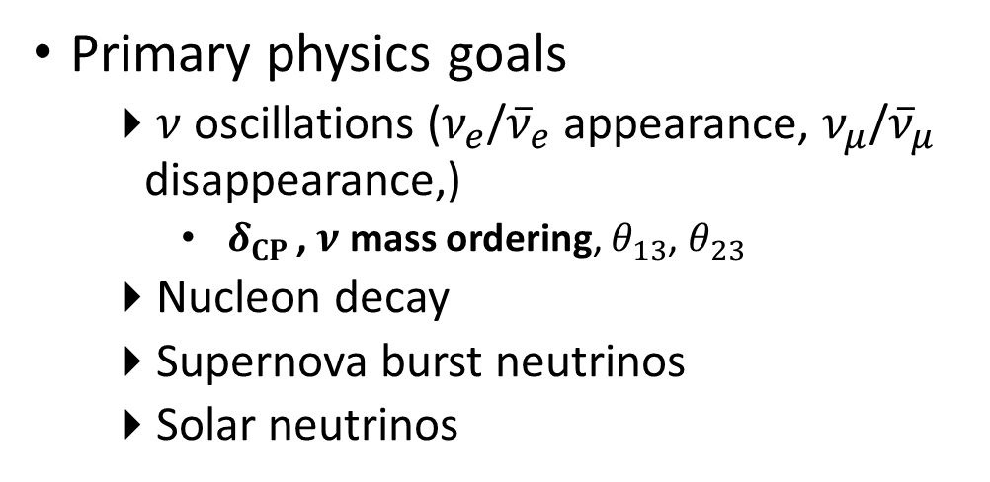
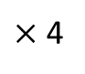
Introducing DUNE
Technical Design Report on arXiv
Vol I: 2002.02967 | Vol II: 2002.03005
Vol III: 2002.03008 | Vol IV: 2002.03010
10kt
$×$ 4
Starts physics operations in mid-2020s
“Deep Underground Neutrino Experiment”
1300 km baseline, far detector 1.5 km underground
Large (4x10kt) far detector and near detector
Wide-band, on-axis neutrino beam
Primary physics goals
$ν$ oscillations ($ν_{e}$/${\overline{ν}}_{e}$ appearance, $ν_{μ}$/${\overline{ν}}_{μ}$ disappearance,)
$δ_{CP }$, $ν$ mass ordering, $θ_{13}$, $θ_{23}$
Nucleon decay
Supernova burst neutrinos
Solar neutrinos
Notes:
and anything else that ~ 70 kt of fine-grained active detector deep underground may find ..
This ambitious program requires careful characterization and calibration of the detector response as well as new engineering and technology solutions

Slide 6
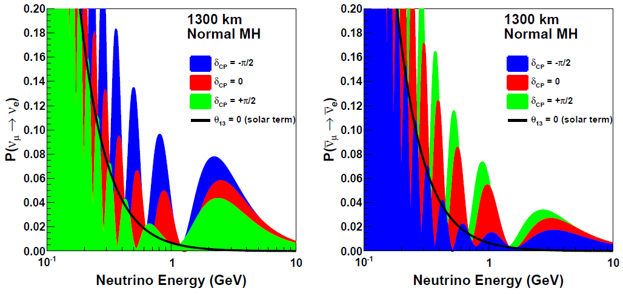
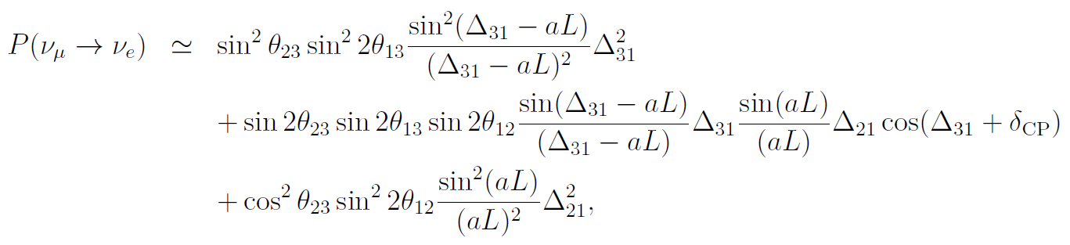
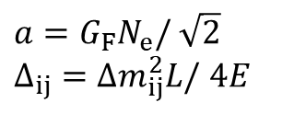
Oscillation Patterns of $ν_{μ}, {\overline{ν}}_{μ}$ Beams over 1300km
arXiv: 2002.03005
DUNE is sensitive to CP violation and mass ordering
1300km baseline: large matter effect to solve mass ordering
$a=G_{F}N_{e}/$ $\sqrt{2}$
$Δ_{ij}=Δm_{ij}^{2}L/$ $4E$
“Matter effect”
Notes:
Wide band coers 1st and 2nd oscillation maxima

Slide 7
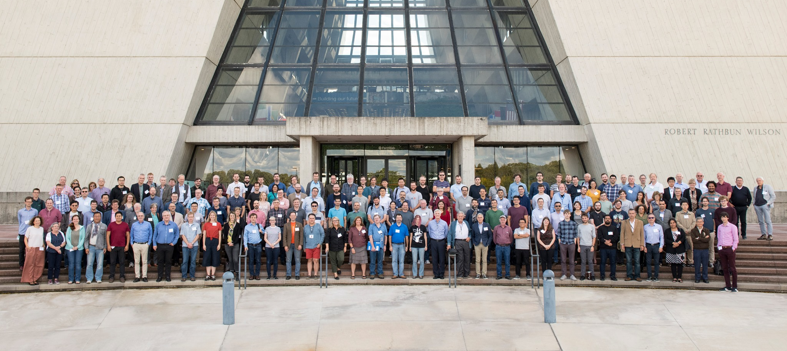
DUNE Collaboration
September 2019 collaboration mtg.
Over 1000 collaborators from 180+ institutions and 30+ countries (w/ CERN)!

Slide 8
Liquid Argon TPC

Slide 9
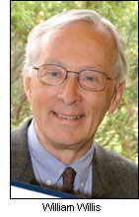
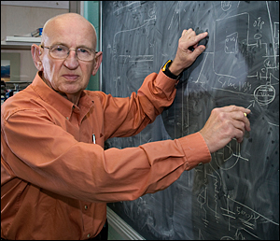
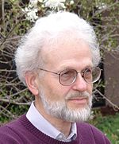

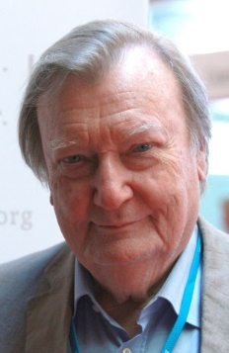
Early History of the Development of LArTPC
W. Willis and V. Radeka, Liquid argon ionization chambers as total absorption detector, NIMA 120:221 (1974)
D. R. Nygren, The Time Projection Chamber: A New 4π Detector for Charged Particles. eConf. C740805:58 (1974)
H. H. Chen et al. A Neutrino detector sensitive to rare process. I. A study of neutrino electron reactions. FNAL-Proposal-0496 (1976)
C. Rubbia, The liquid argon time projection chamber: a new concept for neutrino detector, CERN-EP/77-08 (1977)
V. Radeka (BNL)
H. H. Chen
D. R. Nygren
C. Rubbia

Slide 10


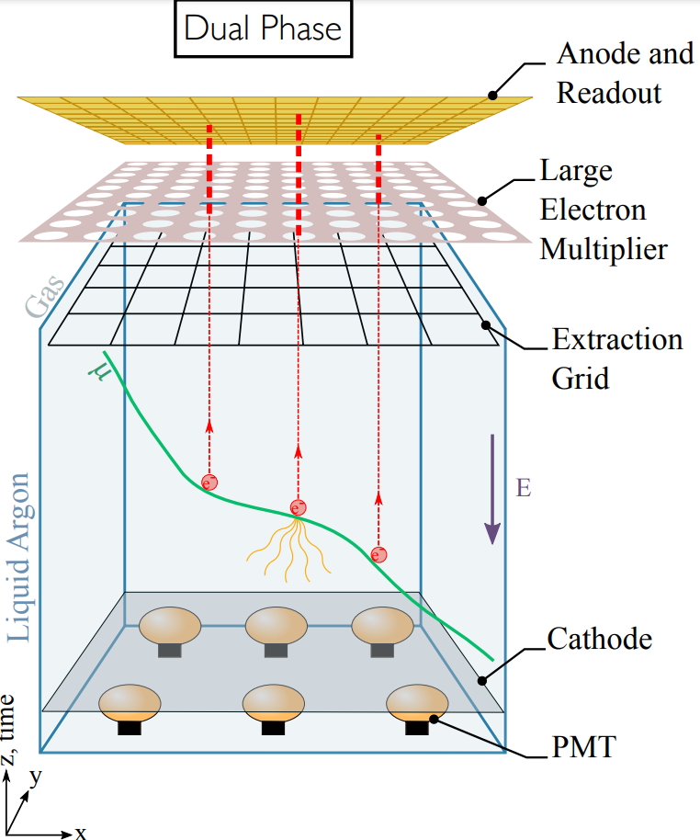
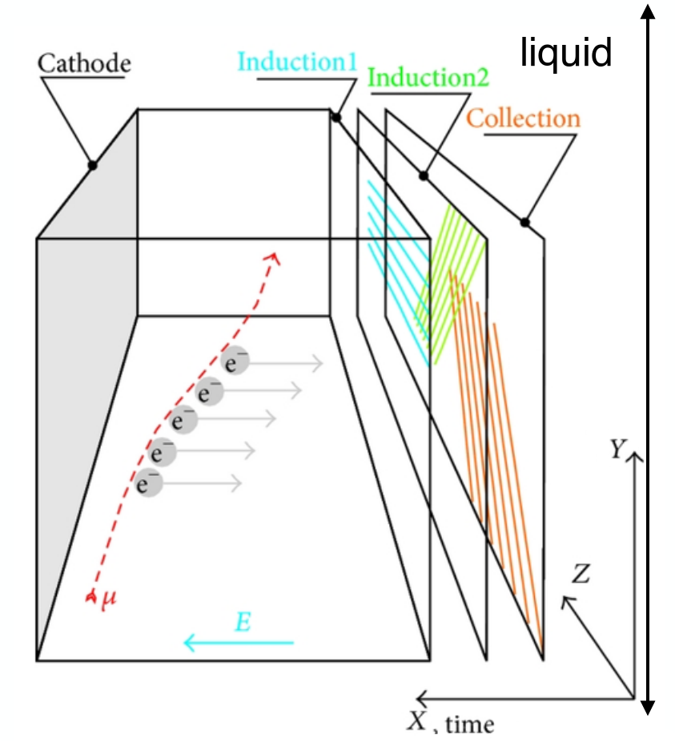
LArTPC: Concepts
Single Phase
Dual Phase
Drift
Drift
Traditional design
Horizontal drift in liquid Ar
Three 1-D wire readout planes (two induction, one collection)
Vertical drift in liquid Ar
Amplification in gaseous Ar
2-D segmented readout

Slide 11
LArTPC: Concepts
Single Phase
Dual Phase
Today’s topic
More reading:
arXiv:2002.02967 [physics.ins-det]
Drift
Drift
Traditional design
Horizontal drift in liquid Ar
Three 1-D wire readout planes (two induction, one collection)
Vertical drift in liquid Ar
Amplification in gaseous Ar
2-D segmented readout
Notes:
Hereafter, I will focus on the single phase, otherwise specified.

Slide 12
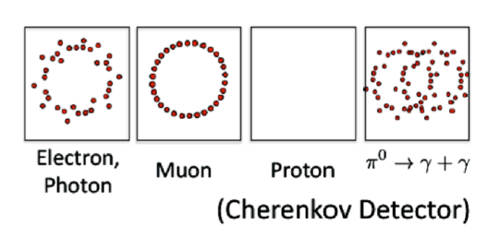
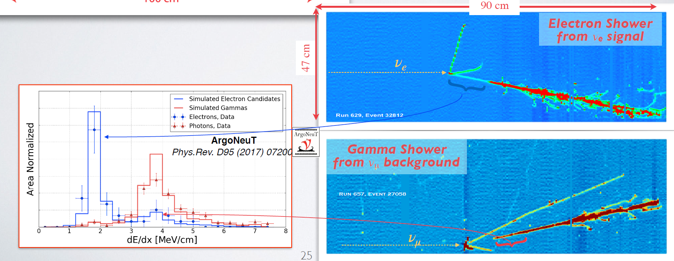
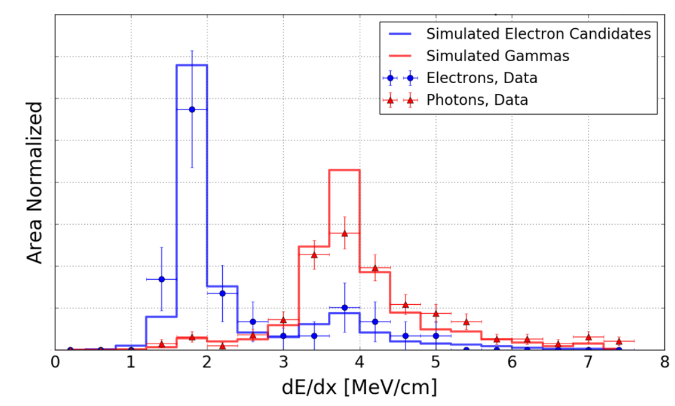

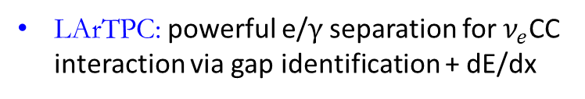
Unique electron ID capability in LArTPC
Bubble chamber: sacrifice mass & calorimetry for topology
Cherenkov: sacrifice topology for mass & calorimetry
Large sampling calorimeters: middle ground solution, coarse resolution, not fully active
LArTPC: powerful e/$γ$ separation for $ν_{e}$CC interaction via gap identification + dE/dx
Phys Rev D.95.072005
Notes:
Describe in order
Nue is our major signal, numu pi0 is our major background
Other detectors …, but LArTPC has very fine resolution in both position and energy calorimetry

Slide 13

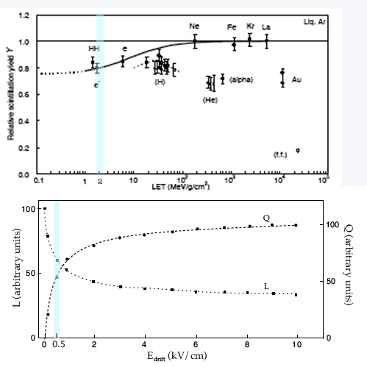
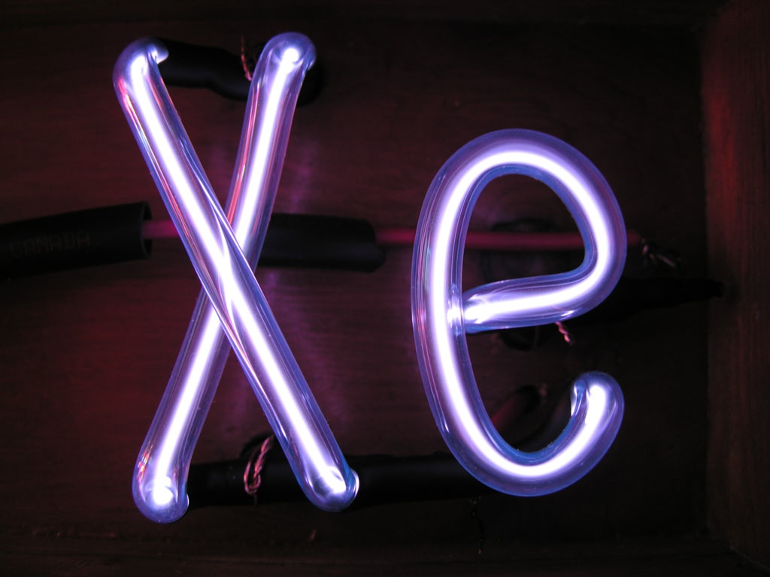
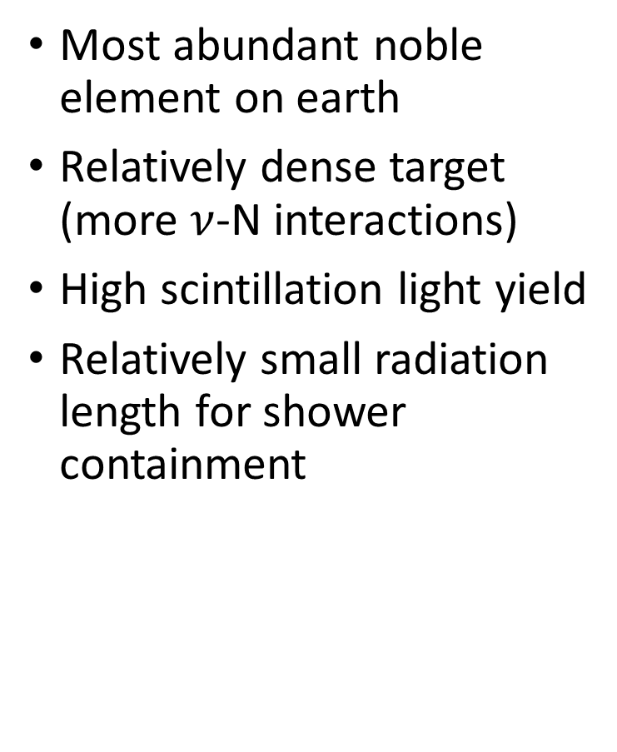
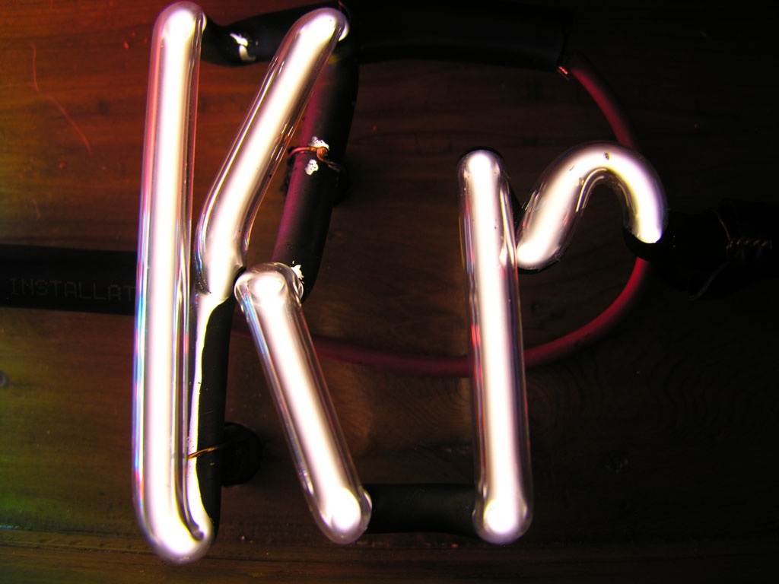
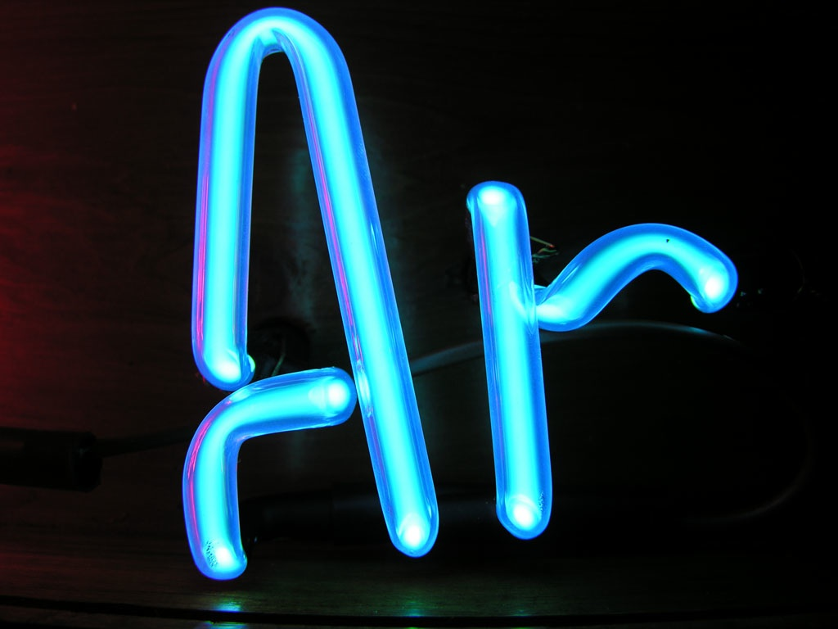


Why Liquid Argon?
Most abundant noble element on earth
Relatively dense target (more $ν$-N interactions)
High scintillation light yield
Relatively small radiation length for shower containment
Atomic Number | 2 | 10 | 18 | 36 | 54
Boiling Point [K] @ 1atm | 4.2 | 27.1 | 87.3 | 120 | 165 | 373
Density [g/cm³] | 0.125 | 1.2 | 1.4 | 2.4 | 3 | 1
Radiation Length [cm] | 755.2 | 24 | 14 | 4.9 | 2.8 | 36.1
dE/dx [MeV/cm] | 0.24 | 1.4 | 2.1 | 3 | 3.8 | 1.9
Scintillation [γ/MeV] | 19,000 | 30,000 | 40,000 | 25,000 | 42,000
Scintillation λ [nm] | 80 | 78 | 128 | 150 | 175
Cost ($/kg) | 52 | 330 | 5 | 330 | 1200
Water
5000 e/mm and 2000 phot./mm at 0.5 kV/cm
Q
kv/cm
Notes:
Most abundant noble element on earth, 1% of the atmosphere

Slide 14
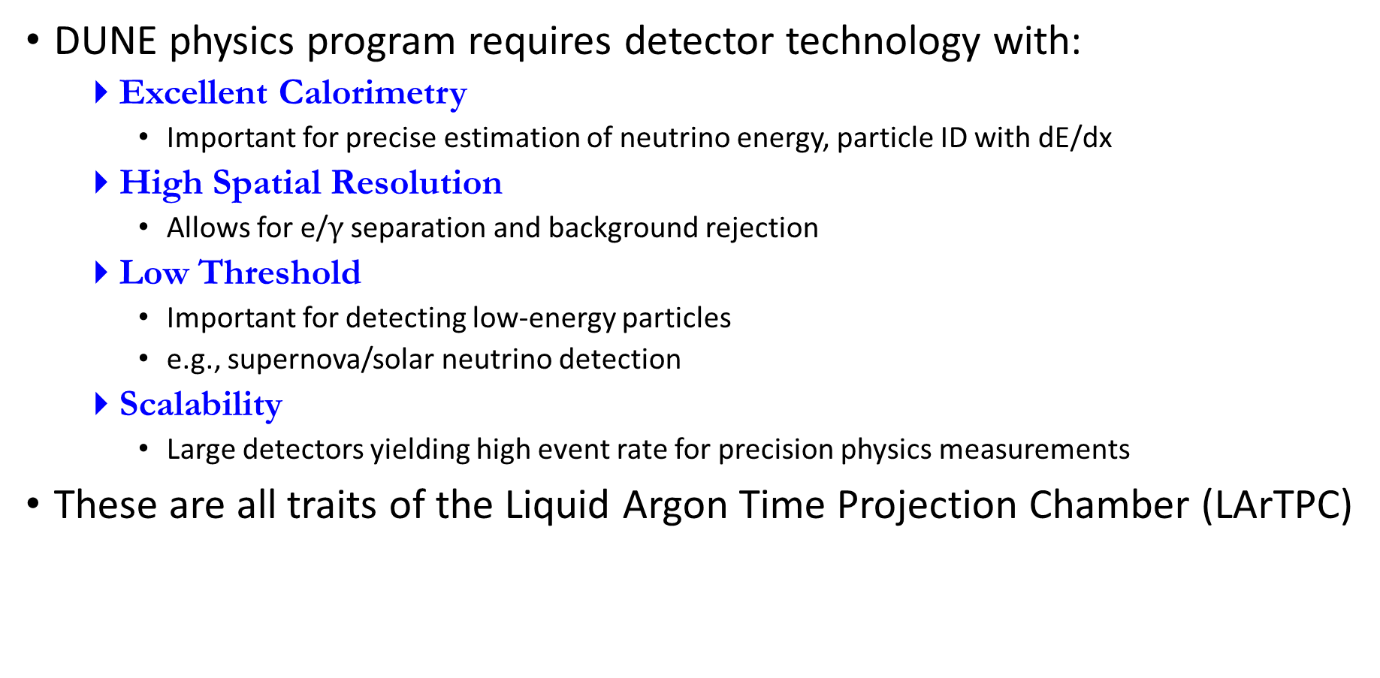
Liquid Argon TPC for DUNE?
DUNE physics program requires detector technology with:
Excellent Calorimetry
Important for precise estimation of neutrino energy, particle ID with dE/dx
High Spatial Resolution
Allows for e/$γ$ separation and background rejection
Low Threshold
Important for detecting low-energy particles
e.g., supernova/solar neutrino detection
Scalability
Large detectors yielding high event rate for precision physics measurements
These are all traits of the Liquid Argon Time Projection Chamber (LArTPC)

Slide 15
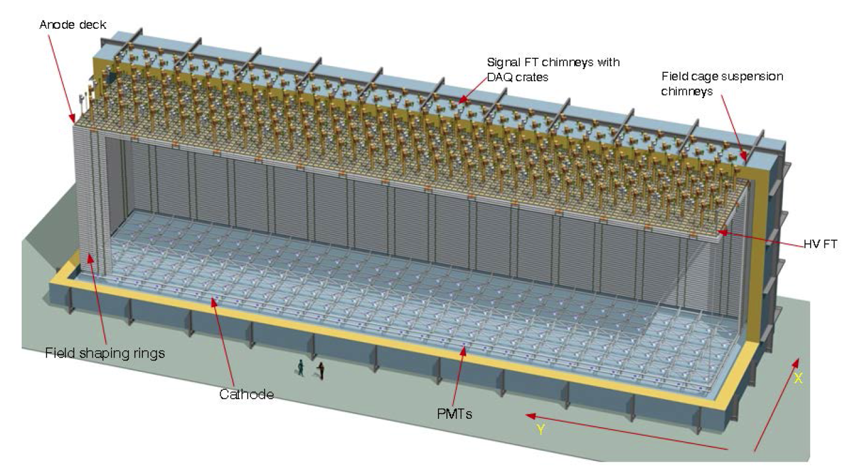
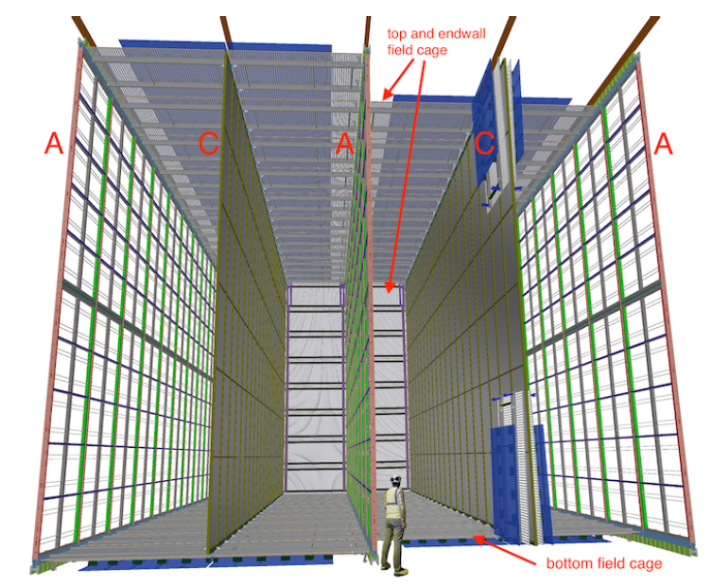
DUNE Far Detector Module
Four 10-kton modules deployed in stages
Two designs being considered: single-phase and dual-phase LArTPC
Single phase will be the first module
4th module: module of opportunity
Single phase design uses modular drift cells (scalable)
Suspended Anode and Cathode Plane Assemblies (APAs and CPAs)
3.6 m drift, 500 V/cm E-field; photon detectors for triggering non-beam events
Underground layout: four 10-kt modules
18m
19m
66m
Dual-phase LArTPC
Single-phase LArTPC
Notes:
4th module: module of opportunity
Explain dual phase vs single phase
Dual phase: has additional signal amplification in the gas Ar

Slide 16
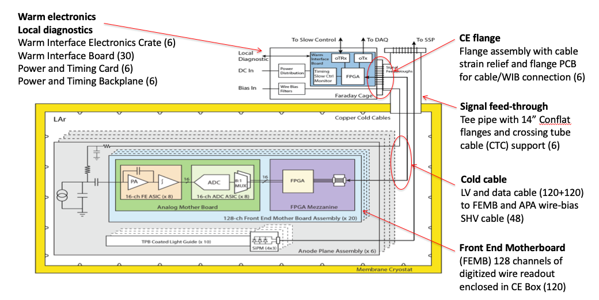
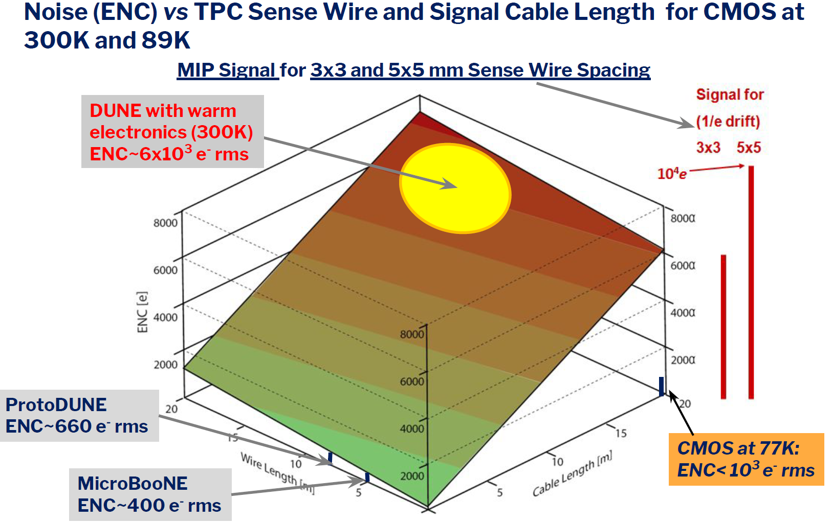
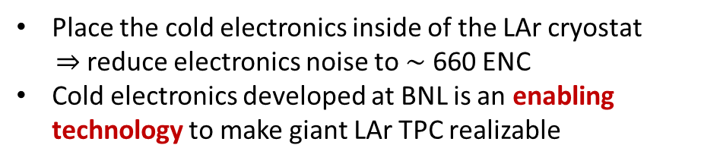
Enabling technology: Cold Readout Electronics
Place the cold electronics inside of the LAr cryostat
$⇒$ reduce electronics noise to $\sim$ 660 ENC
Cold electronics developed at BNL is an enabling technology to make giant LAr TPC realizable
1st International Workshop towards the Giant Liquid Argon Charge Imaging Experiment (2011)
Notes:
Explain what is cold electronics!
Explain more on the noise figure!!
Capacitance on cable is huge for DUNE. Cable length!

Slide 17
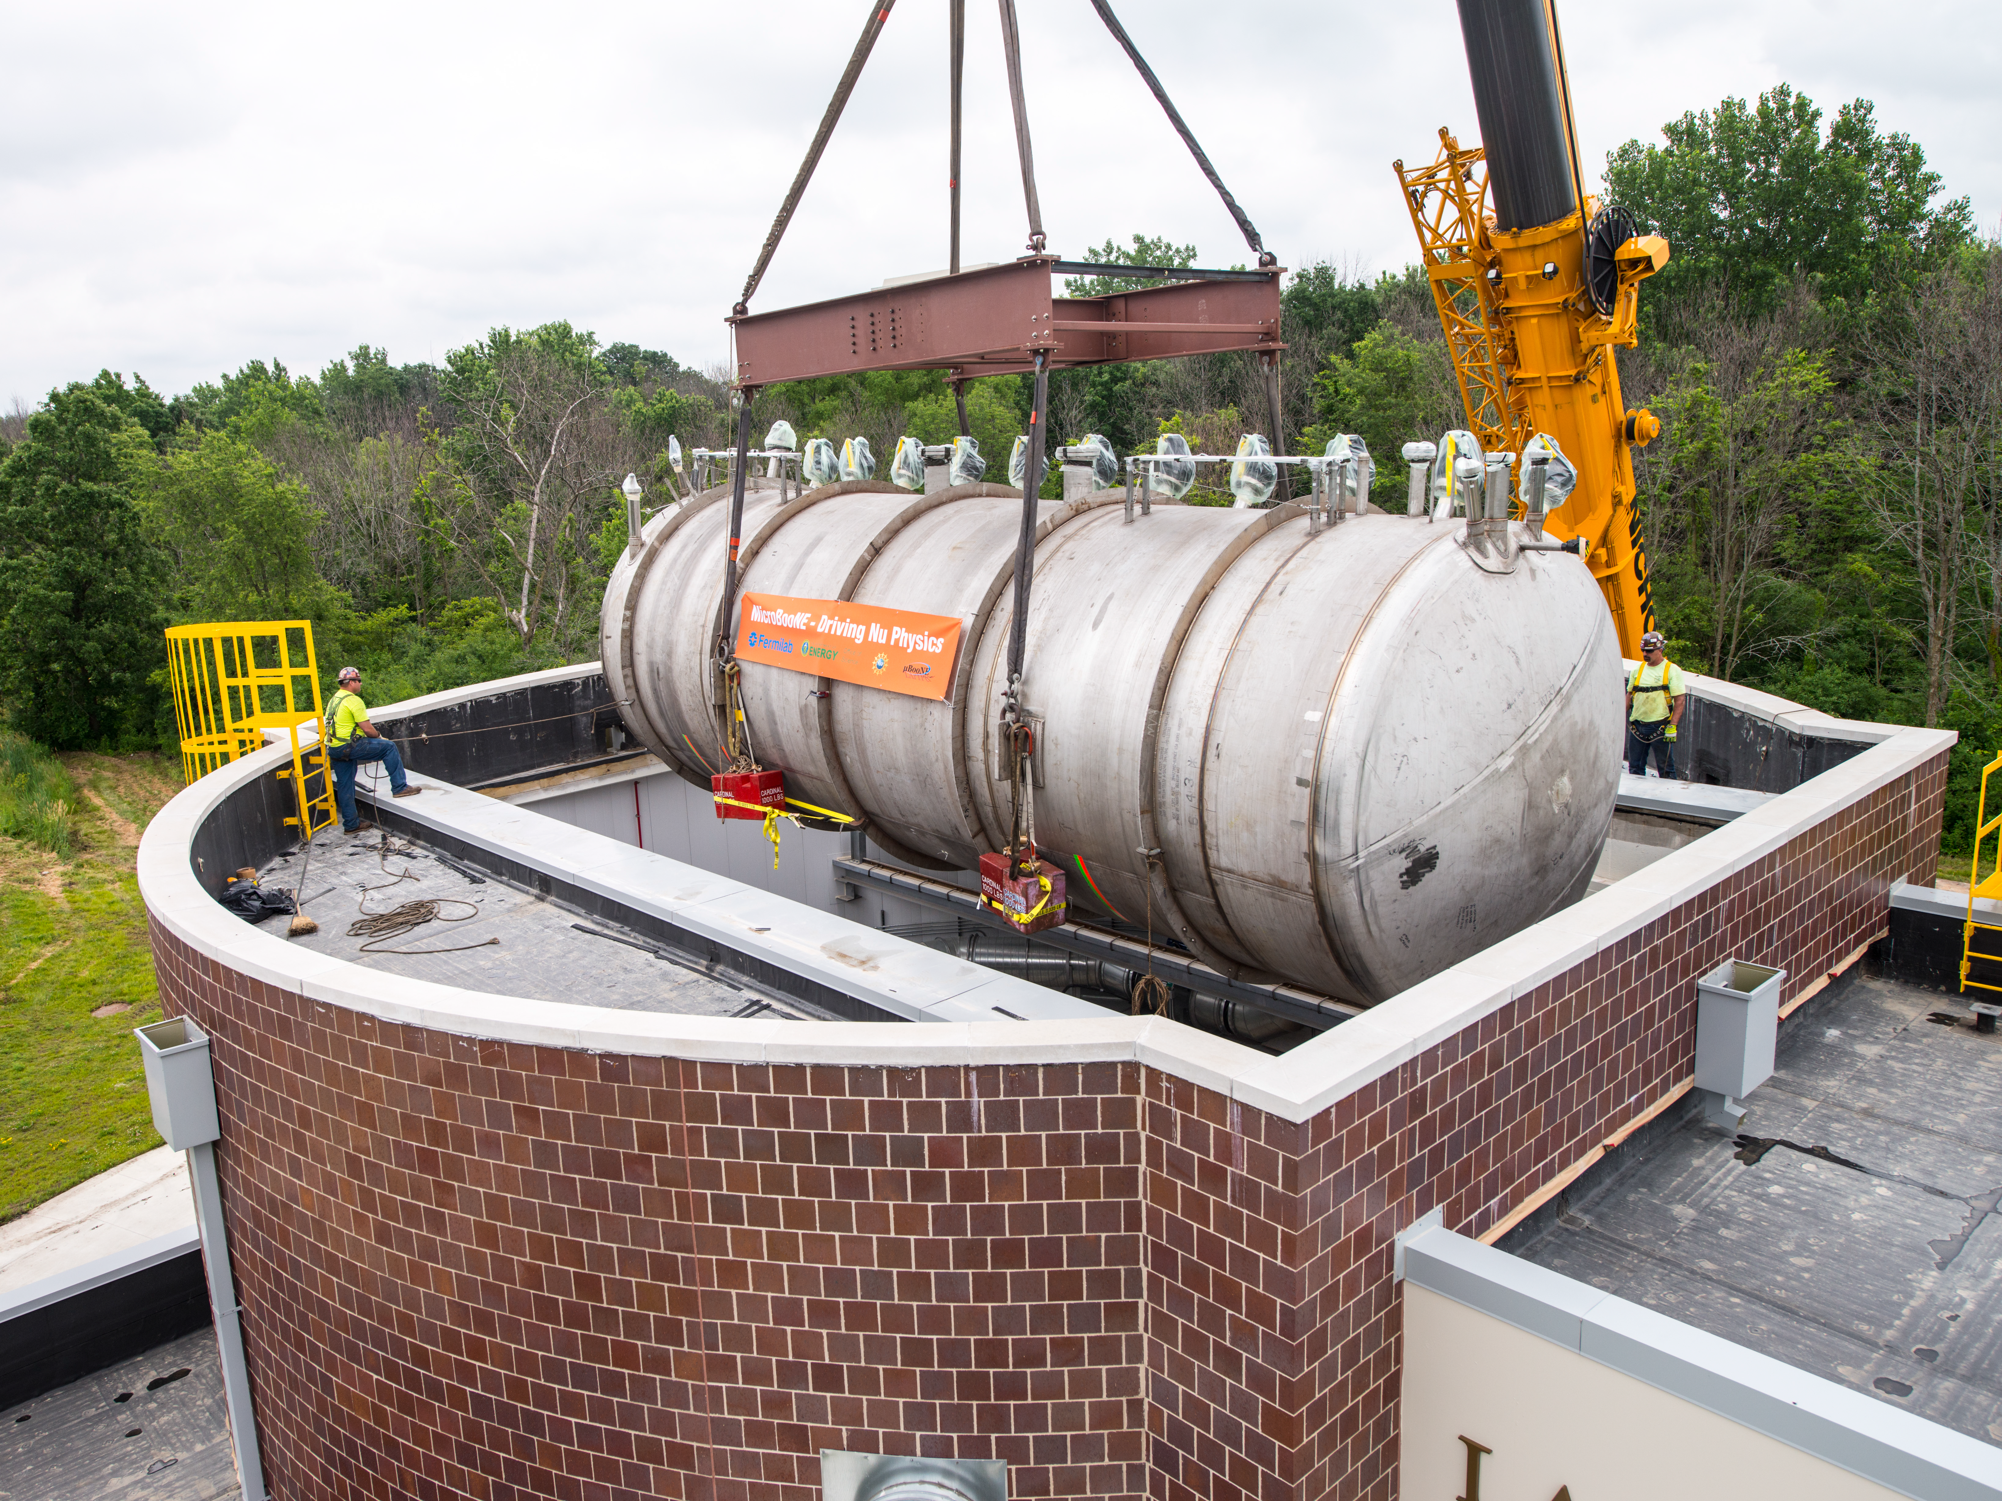
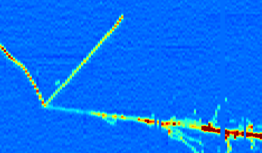
LArTPC Development for Neutrino Physics
ArgoNeuT 0.5t
FNAL NUMI (2009-2010)
ICARUS 300t x2
- CERN CNGS (2010-13)
- FNAL BNB (commissioning)
MicroBooNE 100t
FNAL BNB (2015 - present)
SBND 200t
FNAL BNB (under construction)
Despite many earlier developments, there is still a large gap in target mass
Are we ready for building multiple 10-kt modules ?
DUNE one 10kt module
(mid 2020s - )
Notes:
Despite many developments, there is still a gap in target mass.

Slide 18
DUNE’s Challenges
Scale up in size
Cryostat for 10-kton fiducial, a huge step up from ICARUS & MicroBooNE’s O(100t)
Underground location & expected duration of the experiment
Assembly in underground and no access (no maintenance/repair for ~20yrs) – somehow similar constraints as for HEP experiments in space
Technical challenges
Longer drift and more stringent requirements on:
HV system: higher voltage than all the existing LArTPCs
LAr purity
Detector stability over time: cold electronics/TPC, photon sensors
Overall mechanical engineering
…
Solution to prove the Far Detector design: build a large-scale 1-kton prototype
Notes:
Emphsize

Slide 19
The single-phase prototype

Slide 20
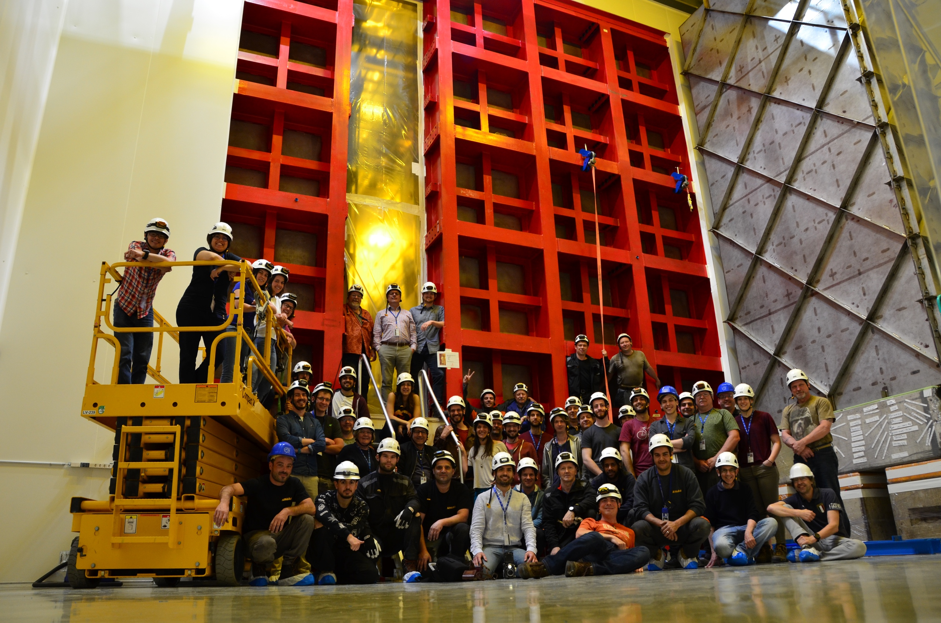
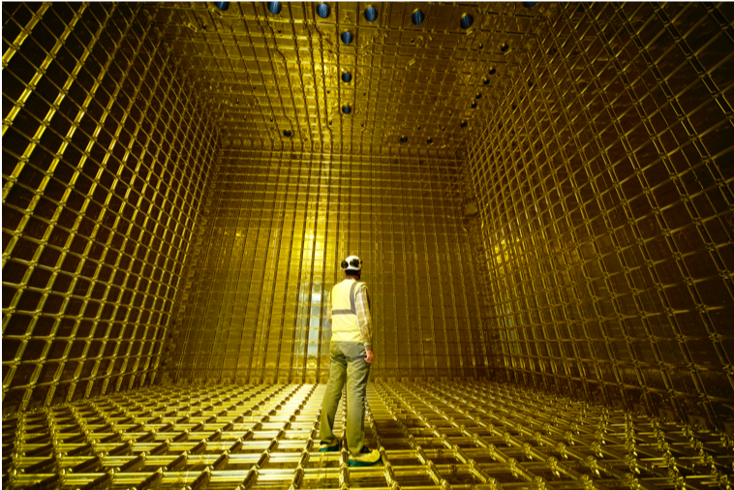
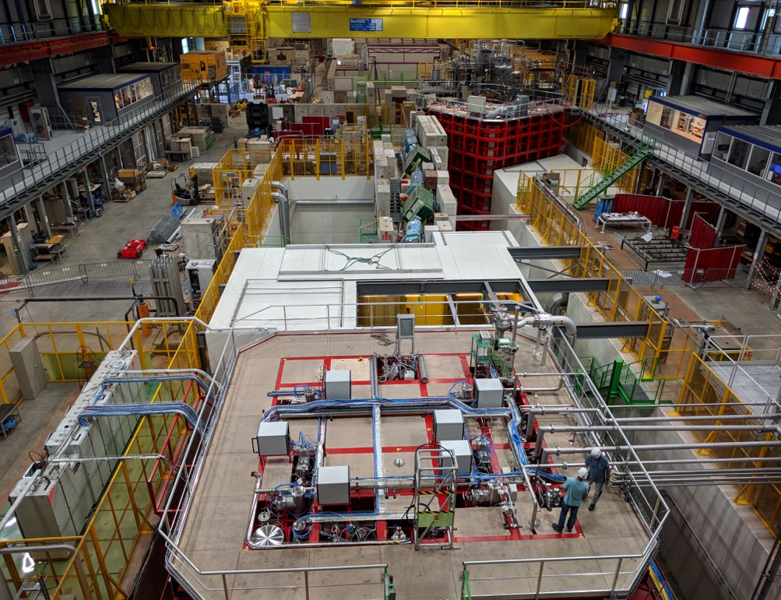
ProtoDUNE Single Phase (SP)
A 0.42-kt (fiducial mass) LArTPC at the CERN Neutrino Platform
World largest monolithic single-phase LArTPC
Prototypes DUNE far detector (FD) components design at 1: 1 scale
Started operation in late 2018
Exposed to cosmic ray & a charged particle beam (0.3 - 7 GeV)
Demonstrate capability of particle identification
Control over DUNE systematics on Hadron-Ar cross section
Notes:
Beamline for demonstrating PID
Proposed by JIM Steward?
- Ask Mary?

Slide 21
ProtoDUNE-SP Overview
6 Anode Plane Assemblies (APAs)
Total 15,360 TPC sense wires/channels with ~ 5mm pitch
99.74%: active channels
Beam
3 Cathode Plane Assemblies (CPA)
Resistive Kapton laminated on dielectric panels
180 kV nominal (2 x 3.6 m drift @ 500 V/cm)
Highest voltage in all LArTPCs to date
3 Types of Photon Detectors
Light collecting bars read out by SiPMs installed in the APA frame (10 detectors/APA)
6m
7.2m
7m
Notes:
APA is important for DUNE’s modular design
DUNE: 150 APA
60 photon detectors -> 3 types of photon detectors

Slide 22
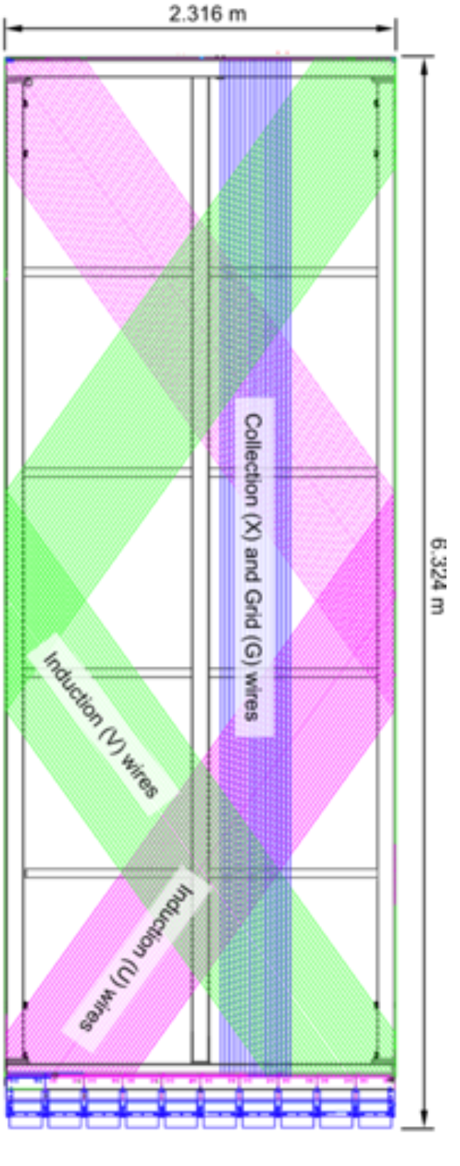
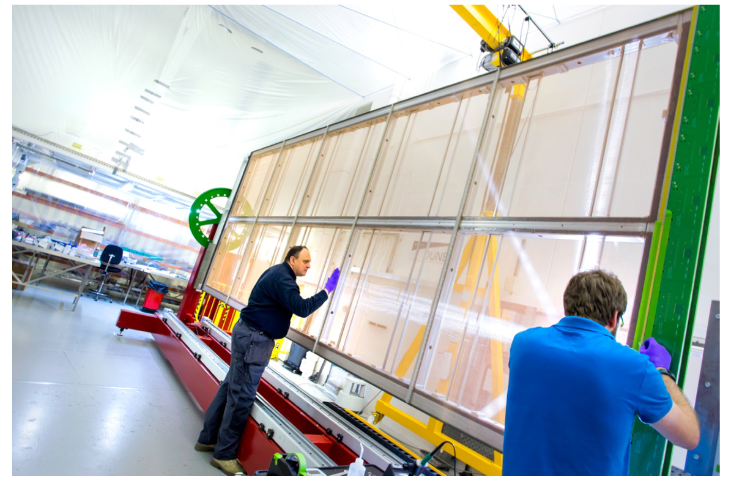
Anode Plane Assembly (APA)
Wrapped wires: reduce number of readout channels, cabling complexity
For a 2560-channel anode (5mm pitch), 2D pixel readout requires half million channels
Saves cost and power consumption of electronics inside LAr
Notes:
2.3m -> limit of the transpotation

Slide 23
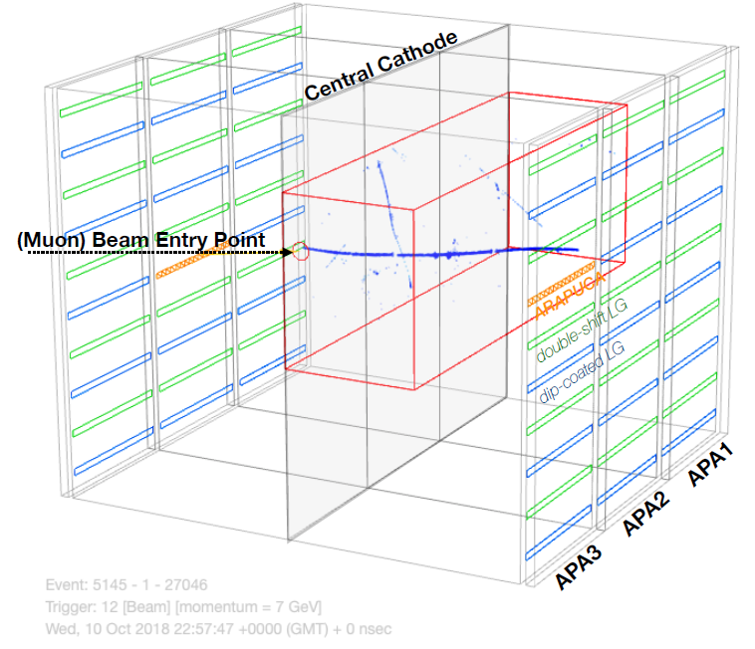
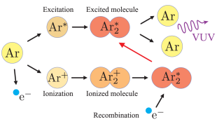
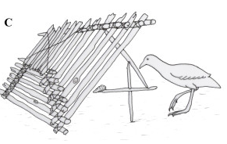
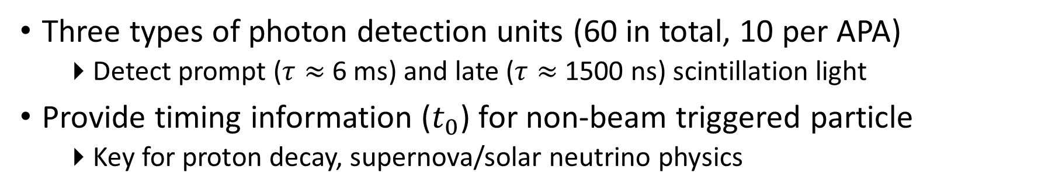
Photon Detection System (PDS)
Three types of photon detection units (60 in total, 10 per APA)
Detect prompt ($τ≈$ 6 ms) and late ($τ≈$ 1500 ns) scintillation light
Provide timing information ($t_{0}$) for non-beam triggered particle
Key for proton decay, supernova/solar neutrino physics

Slide 24

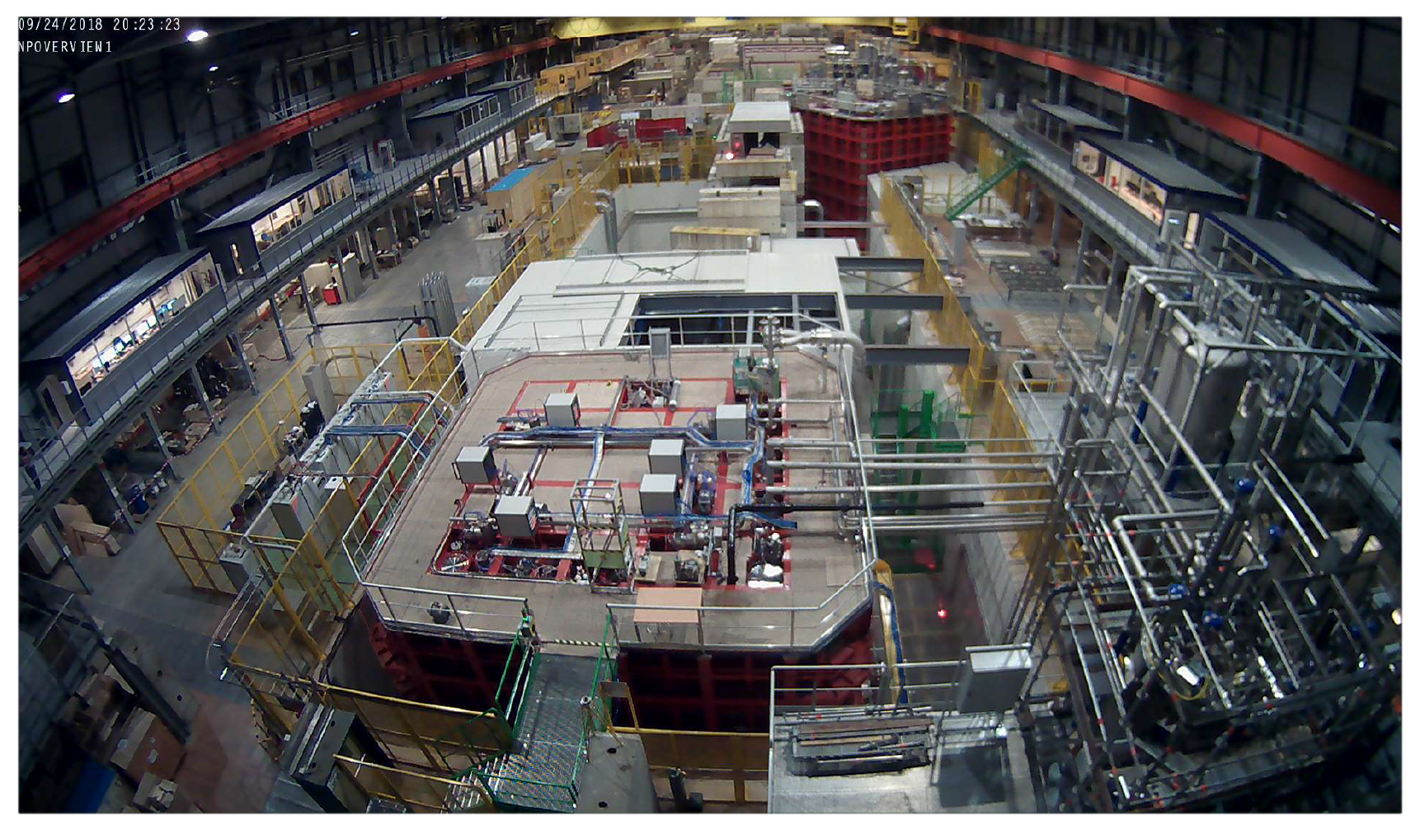

The CERN Neutrino Platform
A new dedicated experimental facility
Dec. 12, 2015
Sept. 21, 2018

Slide 25


Slide 26

ProtoDUNE at CERN Neutrino Platform
The ProtoDUNE-SP is in a tertiary extension branch of the H4 beamline in the CERN EH1N extension

Slide 27



ProtoDUNE-SP on the Beamline
Tertiary beam with momentum range: 0.3$\sim$7 GeV/c
Spectrometer to measure the particle momenta
Particle ID from time of flight and two Cherenkov detectors
Over 4 million beam triggers of charged particles

Slide 28

Successful High Voltage System

Slide 29

e-Lifetime and LAr Purity
Electron lifetime measures the LAr purity
Two independent monitoring are highly correlated and crosschecked
Purity Monitors outside of TPC, 20 V/cm E-field
In situ measurement inside TPC ($dQ$/$dx$ vs. $t$) with cosmic rays, 500 V/cm E-field
Three Purity Monitors at 1.8 m, 3.7 m and 5.6 m from bottom of the cryostat
Cosmic rays
Cosmic rays
Purity Monitor

Slide 30


Slide 31






Video | Online gallery by Chao Zhang (BNL)
pion-Ar charge exchange
6 GeV/c pion
Time
6 GeV/c electron EM shower
1 GeV/c stoppig proton
6 GeV/c kaon
Wire

Slide 32

High multiplicity cosmic shower: “muon bundle”
Notes:
Muon bundle!

Slide 33
Detector Performance
TPC
Noise Level and Charge Extraction
Calorimetry: dE/dx
Particle Identification
PDS
Light Yield
Calorimetric Energy from Light

Slide 34


Cold Electronics Performance
JINST 15 (2020) 06, P06017
Cold electronics installed on APA
Notes:
Move to later

Slide 35

Noise Level
The noise level well agrees the expectation from the cold electronics design
Software filter further reduce the noise
Notes:
Low noise level even before the software filter, hardware is good

Slide 36


TPC Channels and Electronics Noise
Total TPC channels: 15360
99.74% (15320 of 15360) TPC channels are active
92.83% (14259 of 15360) TPC channels are working with excellent noise performance (ENC < 800e-)

Slide 37

2-D Images from One Wire Plane
Wire
Time
Notes:
What’s X and Y axis? Explain and label

Slide 38


2-D Deconvolution Technique
JINST 13 P07006 (2018)
A novel signal processing technique developed at BNL for MicroBooNE
Consider the long-range induction effect in a 2D deconvolution kernel (time + wire)
$$M_{i}{(}t_{0})=\int_{t}{\left(R_{0}(t_{0}−t)⋅S_{i}(t)+R_{1}{(}t_{0}{−}t{)}⋅S_{i+1}(t)+...\right)⋅}dt$$
$$M_{i}{(}t_{0})=\iint_{t, α}{R\left(t_{0}−t, i−α\right)⋅S\left(t, α\right)⋅dt dα}$$
t: time, $α$: wire
Equivalently, recover ionization charges from induced current from all adjacent wires
Notes:
One of the areas that is closest to my heart is the TPC simulation and signal processing.

Slide 39




Revisit the Concept
Cartoon animation made by Bo Yu (BNL)
Ionization electrons drifted and induced current read out by three (1D) wire planes
Notes:
Emphasize the position and energy determination
Current shape is not a key point here

Slide 40



2-D Deconvolution Technique
JINST 13 P07006 (2018)
A novel signal processing technique developed at BNL for MicroBooNE
Consider the long-range induction effect in a 2D deconvolution kernel (time + wire)
$$M_{i}{(}t_{0})=\int_{t}{\left(R_{0}(t_{0}−t)⋅S_{i}(t)+R_{1}{(}t_{0}{−}t{)}⋅S_{i+1}(t)+...\right)⋅}dt$$
$$M_{i}{(}t_{0})=\iint_{t, α}{R\left(t_{0}−t, i−α\right)⋅S\left(t, α\right)⋅dt dα}$$
t: time, $α$: wire
Equivalently, recover ionization charges from induced current from all adjacent wires
Notes:
One of the areas that is closest to my heart is the TPC simulation and signal processing.

Slide 41







Signal Processing Example
wire 385
(Shallow angle track)
$−$ Raw waveform
$−$ Deconvolved signal
After Noise Filtering
After 2-D Deconvolution
wire 385
wire 385
Time [$μ$s]
wire 385
(Large angle track)
Topology dependence
Bipolar signal deconvolved into a unipolar charge distribution
Long tracks in drift direction are obscure in the induction waveform
cancellation of successive bipolar signals $⇒$ recovered via the 2D deconvolution

